Slide 1
Exploration of Machine Learning Optimization Algorithms in HTTP Latency Tuning on NGINX
Krzysztof Sywula krz.sywula@bytedance.com
Jasmine Mou jasmine.mou@bytedance.com
System Technologies and Engineering, ByteDance
Notes:
Questions:
Why bayesian not other ML: 1) works well for large set of parameters; 2) will try the other in future work

Slide 2
Problem Statement
Operating system tuning for better overall performance of NGINX
2

Slide 3
Agenda
Example of NGINX proxy scenario running various workloads
Existing methods of NGINX and OS tuning
Machine learning tuning as better alternative to manual tuning
Machine learning tuning experiment with 16 specific sysctl parameters
Future Autotuning work
3

Slide 4
NGINX
reverse
proxy
clients
backend servers
4

Slide 5
Existing methods of tuning
Involve expert knowledge
Static and permanent tuning
Not scalable
5

Slide 6
What is the goal of the tuning?
Low latency vs high throughput
6

Slide 7
Areas to look into
Memory Management
CPU scheduling
Networking
I/O scheduling
7

Slide 8
CPU scheduling
Choose the scheduling algorithm
Configure scheduling parameters
Some even deploy custom scheduler
8

Slide 9
To NUMA or not to NUMA
May want to avoid NUMA for low latency applications
9

Slide 10
Read and Write TCP buffers
How many, what size?
10

Slide 11
Memory swapping
Best to disable to achieve very best performance but not always feasible
11

Slide 12
Sysctl has over 1000 parameters to tune!
12

Slide 13
Can machine learning algorithm determine the best configuration?
13

Slide 14
Can all those parameters be adjusted dynamically?
14

Slide 15
Our machine learning tuning attempt
Experiment design
Goal/Metric to evaluate:
HTTP Latency
Parameters to tune:
16 sysctl parameters selected from 4 domains
Memory Management: swappiness, vfs_cache_pressure, dirty_ratio, min_slab_ratio, min_unmapped_ratio.
CPU Scheduler: sched_latency_ns, sched_min_granularity_ns, sched_wakeup_granularity_ns.
Networking: tcp_reordering, tcp_limit_output_bytes, tcp_notsent_lowat, tcp_min_tso_segs.
Block I/O: fifo_batch, read_expire, write_expire, writes_starved.
15

Slide 16
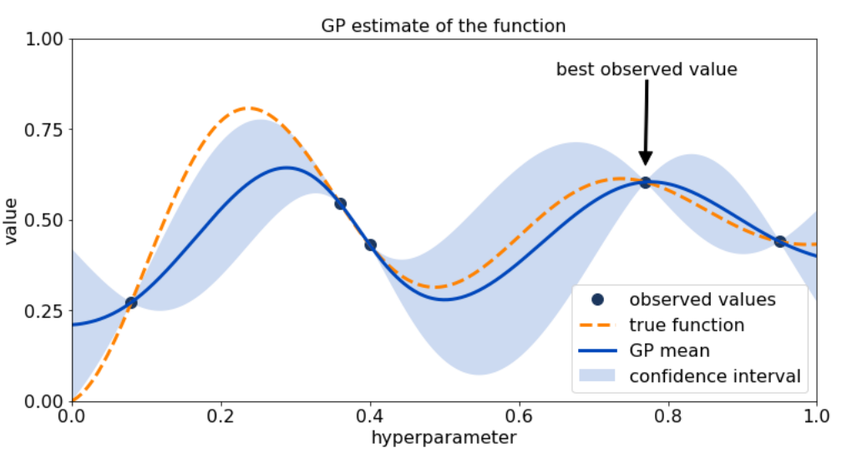
Our machine learning tuning attempt
Experiment design
Optimization algorithm:
Bayesian Optimization
Recipe:
start with initial set of observed values.
create a surrogate function.
get the acquisition function.
choose the highest point (maximal problem).
find the value of the highest point.
repeat 1 to 5.
16

Slide 17
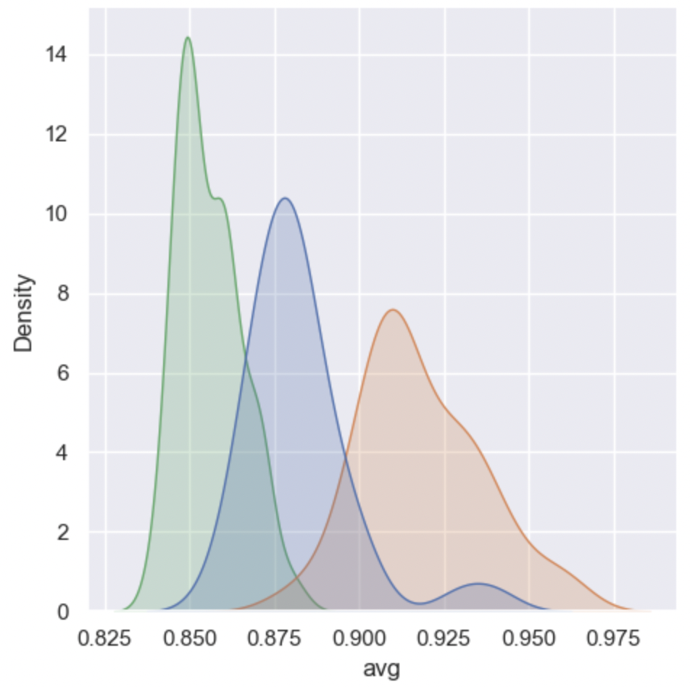
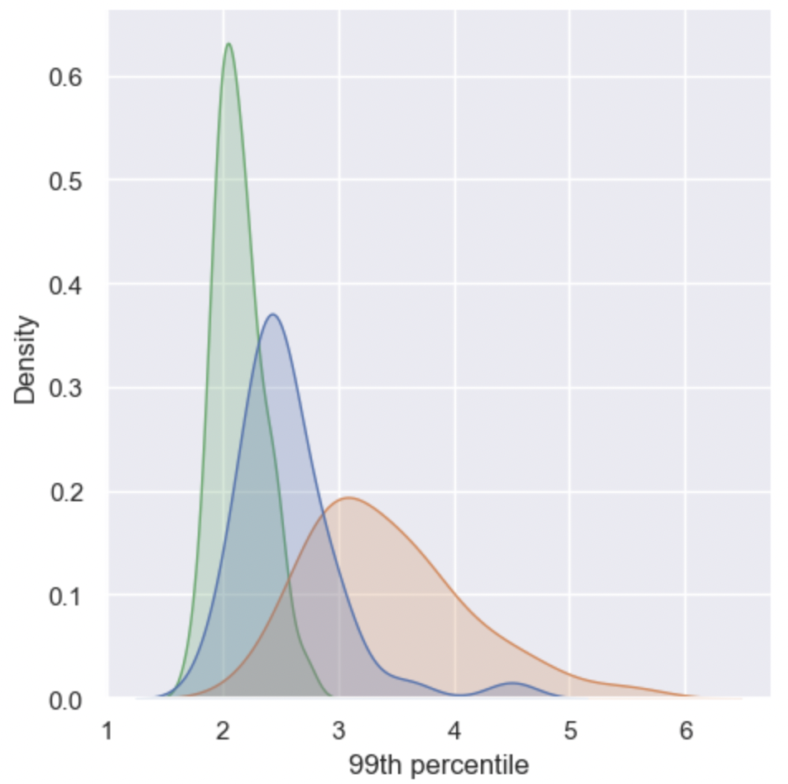
Our machine learning tuning attempt
Experiment setup
Benchmarking tool:
wrk (wrk -t12 -c200 -d30s --latency http://address/index.html).
for each batch: run wrk for 30 seconds, and collect p99 value to represent the result from this batch.
run 30 batches and get 30 p99 values.
final metric formula:
HTTP latency = mean + 𝝰 x std. dev.
𝝰=0.1
Legend:
Default Parameter Set
Parameter Set 1
Parameter Set 2
Results analysis:
we keep the min value as the final result.
values are not constant, but distribution consistency can be observed, whether it's average value or p99.
17

Slide 18
Our machine learning tuning attempt
Experiment Results
No. | Description | Comments | Run Time per data point (approx.) | Min. HTTP Latency (ms) | Percentage Improvement
1 | Manual Testing (37) | NA | 30 min | 2.66 | Baseline
2 | Auto Tuning with Bayesian Optimization | Acquisition Function = UCB | 17 min | 2.97 | -11.6 %
3 |  | Acquisition Function = POI With prior knowledge | 17 min | 2.57 | 3.4 %
4 |  | Acquisition Function = UCB With prior knowledge | 17 min | 2.46 | 7.5 %
5 |  | Acquisition Function = EI With prior knowledge | 17 min | 2.44 | 8.2 %
6 |  | Acquisition Function = EI With prior knowledge Better handling integer nature | 17-20 min | 2.34 | 12 %
18
Check p.24 for optimization results of parameter values
Notes:
单击此处添加文本

Slide 19
Our machine learning tuning attempt
Animation of tuning process
19

Slide 20
Our machine learning tuning attempt
Fine tuning tricks
Prior knowledge from kernel SMEs:
With 16 parameters and huge range sets it becomes difficult for bayesian to converge soon.
So we took inputs from kernel SME’s on parameter ranges.
Ex: range of sched_latency_ns is from 1200000 to 24000000 -- instead of using all the values we use only increments of 1200000.
Different acquisition function settings
After prior knowledge we also explored different acquisition functions in the bayesian optimization:
UCB (Upper Confidence Bound)
EI (Expected Improvement)
POI (Probability of Improvement)
20

Slide 21
Our machine learning tuning attempt
Observations & findings
Manual testing may not give fully optimal performance.
More parameters, more time to tune.
Prior knowledge will contribute to better performance.
Dynamic tuning vs static one-time tuning:
Static tuning:
time-independent: objective function does not vary with respect to time.
lower computation cost.
Dynamic tuning:
time-dependent: when environment variables are also dynamically changing.
21

Slide 22
Future work
TCP Congestion Control algorithm choice.
TCP Congestion Control settings.
Configure memory thresholds tcp_rmem and tcp_wmem to prevent packet dropping.
Configure TCP buffer sizes rmem_max and wmem_max.
Test other optimization algorithms over different workloads.
22

Slide 23
Thank you!

Slide 24
Appendix. Optimization Results
Kernel parameters | Parameter values | Kernel parameters | Parameter values
sched_latency_ns | 18000000 | min_slab_ratio | 12
sched_min_granularity_ns | 14400000 | min_unmapped_ratio | 5
sched_wakeup_granularity_ns | 2500000 | swappiness | 0
tcp_limit_output_bytes | 5259264 | vfs_cache_pressure | 80
tcp_min_tso_segs | 12 | fifo_batch | 4
tcp_notsent_lowat | 2108751872 | read_expire | 300
tcp_reordering | 5 | write_expire | 1000
dirty_ratio | 28 | writes_starved | 4
24

